Slide 2
Journey Of Saints so Far
Saints - Saints Is a Rugby Club Founded By Mr. Aaron Dmello In The Year 2014. Based At Old Goa The Club Which Looks After Developing The Game In The Eastern Part Of Goa
Number of Camps Conducted across East Goa – Over 1000 Camps
Number of Institutes Academies – Over 25 Schools And Institutes
Professional Players in East Goa – Over 100 Players
Affiliations – Goa Rugby Union and Indian Rugby Football Union
Team Strength- Across East Goa from Schools, Villages, International Institutions etc
Social Media Reach – We are active On Social Media I.E. Facebook Twitter Instagram

Slide 3
Some of Our Achievments
We Have Participated In All The Tournaments Organised By Goa Ruby Union
Our Trophy Count as of Now Is 15 Trophies.
This Year Saints Have Grabbed Two Trophies U-11 Boys Are Currently The State Champions. While The U-16 Boys Ended Up being The Runners Up.
5 Of Our Academy Players 4 Boys 3 Girls Represnted Goa At The U- 18s , U-14s And Senior Societe Genereal Rugby India Nationals
In The Tournament Our Academy Players Performed exceptionally well.Some Of Players Managed to catch the eyes of Indian selectors.
We at Saints Believe That There Is a Lot Of Raw talent In our area which needs to be developed .

Slide 4
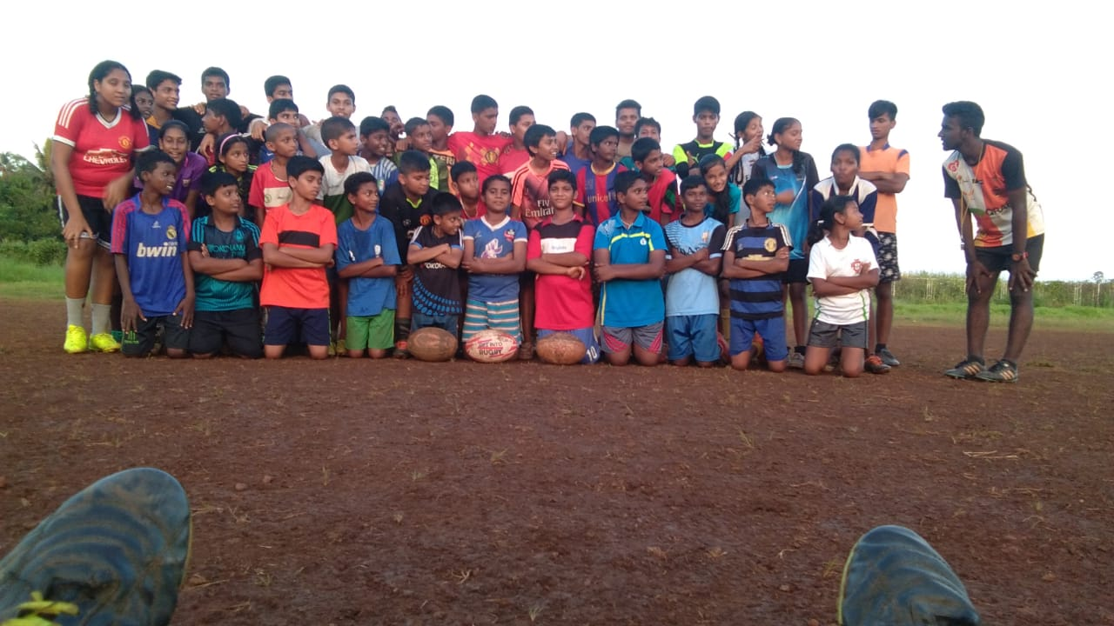
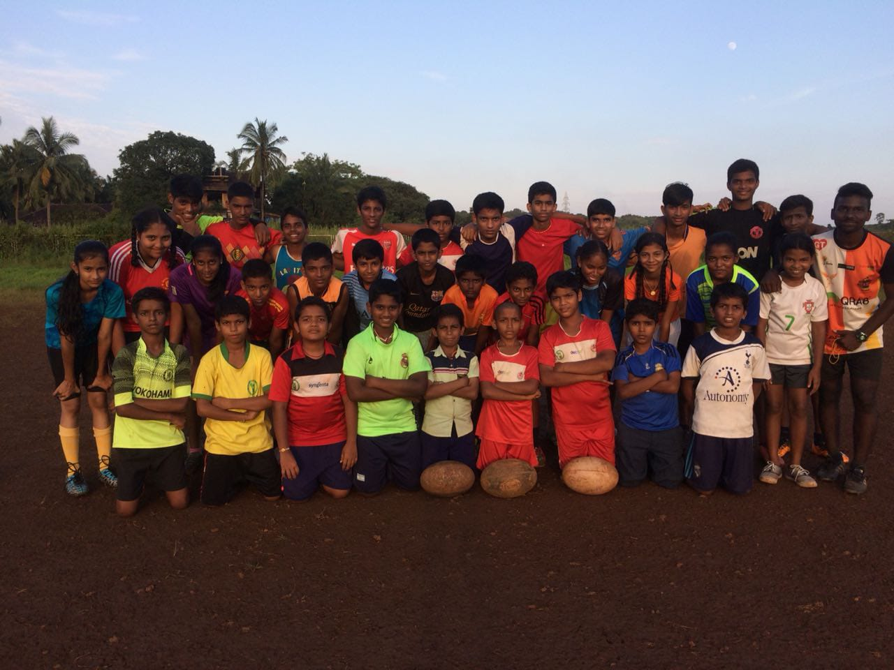
DEVELOPMENT THIS YEAR
We Have Already Completed Get Into Rugby India Festivals in 11 Different Schools involving around 83 Students
Get Into Ruby Is one of the worlds leading grassroot programme
Players Selected From Get Into Rugby are then Selected For The Saints Academy .
This Year We Have Selected 83 Players for our Academy

Slide 5
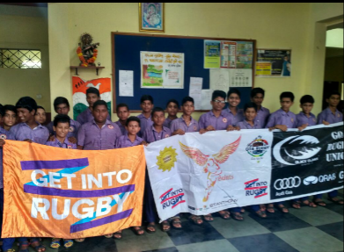
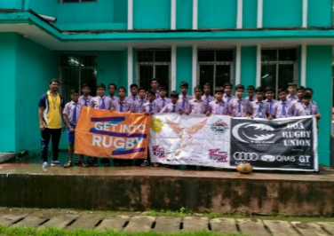
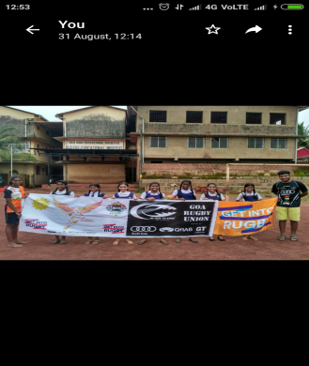
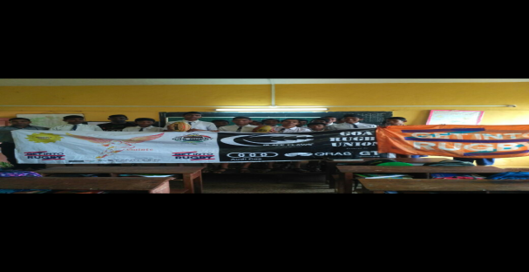
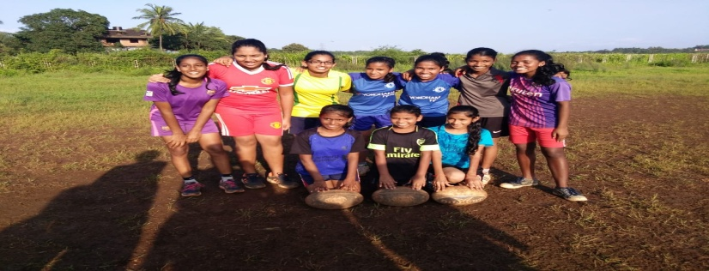
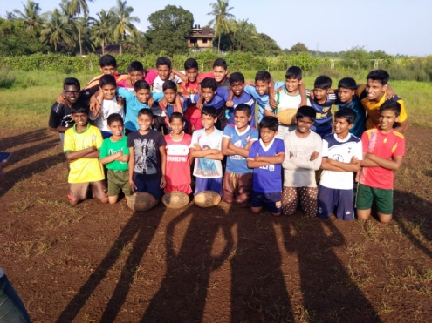
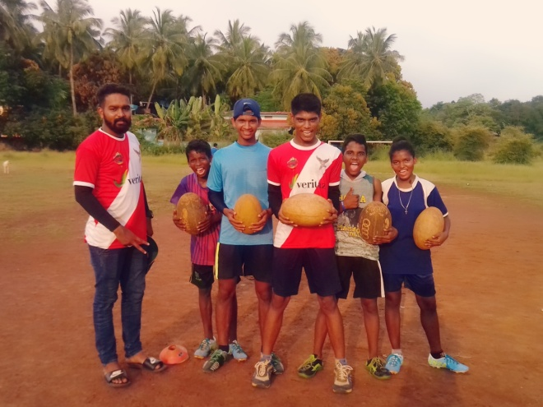
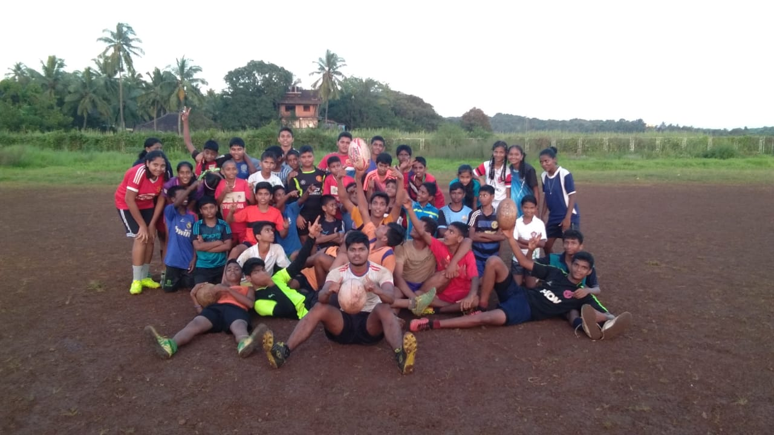
PICTURES OF CAMPS HELD IN THE LAST 5 YEARS.

Slide 6
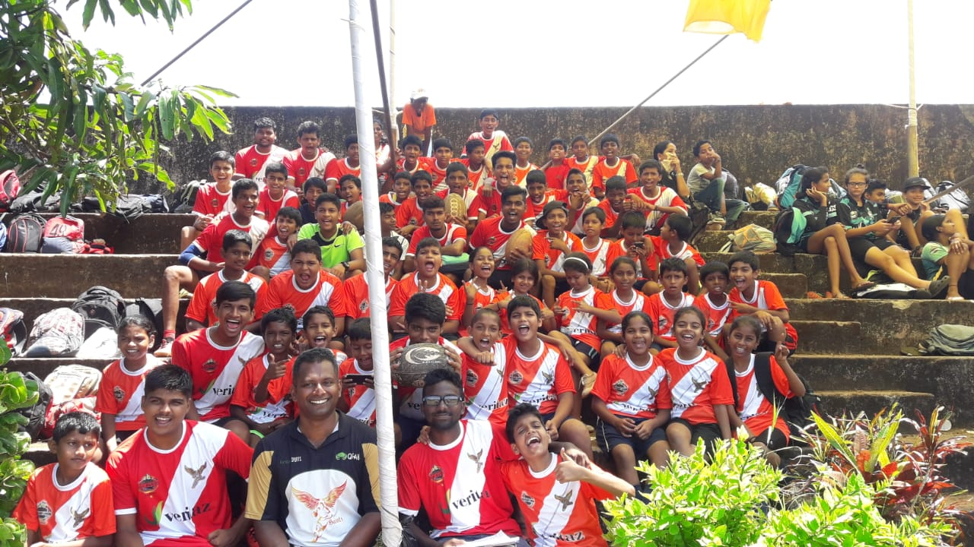
Saints This Year
Saints Are Going Too field the following teams .
U-11 Touch ( Boys & Girls )
U-14 Touch (Boys & Girls)
U-16 Contact (Boys & Girls)
U- 18 Contact ( Boys & Girls)
Seniors Contact ( Men & Women)

Slide 7
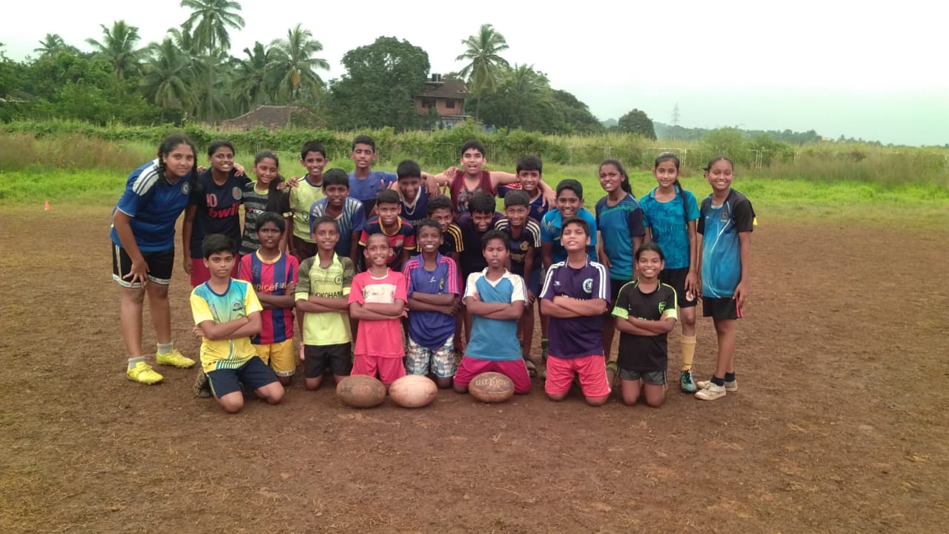
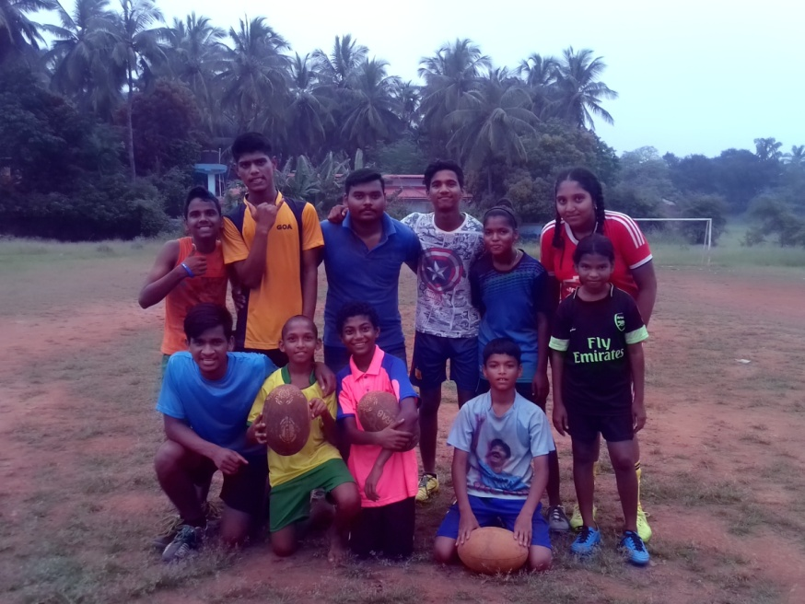
SOME CAMPS HELD THIS YEAR

Slide 8
THANK YOU

